Slide 1
Cyber-physical system-based real-time monitoring and visualization of greenhouse gas emissions of prefabricated construction
GuiwenLiu, HaoYang, YanFu, ChaoMao, PengpengXu, JingkeHong, RongyanLi
Journal : Journal of Cleaner Production Volume 246, 10 February 2020, 119059
Presenter: Byeong Seop Kim
for98ever@naver.com

Slide 2
Contents
1. Introduction
2. Literature review
3. Methodology
4. Quantitative model development
5. CPS-based system configuration
6. Considerations for application
7. CONCLUSION

Slide 3
1. Introduction
○ Most traditional GHG emission assessment methods focus on pre- or post-analysis, which are not useful for monitoring and studying GHG emissions during the construction stage (Fu et al., 2014, Luo et al., 2016) Thus, the real-time monitoring of GHG emissions is highly significant.
○ First, such method can reduce GHG emissions during the construction stage and improve environmental performance (Seo et al., 2016).
○ Second, the collection and analysis of GHG emission data are helpful in the government’s formulation of energy conservation and emission reduction policies (Tao et al., 2018).
○ Third, the GHG emission database collected by the system will facilitate the use of clean energy or technology by comparing real-time GHG emissions under different mechanical and energy use conditions to optimize the “cost, quality, schedule, and GHG emissions” of the construction industry
○ Thus, a real-time GHG emission monitoring system must be developed.

Slide 4
2. Literature review
2.1. Traditional LCA approach
○ PLCA is a bottom-up method that calculates the environmental impact of each process by defining the corresponding required energy consumption and materials (Mao et al., 2013, Yan et al., 2010). Thus, PLCA is a relatively accurate method for assessing GHG emissions.
○ By contrast, I–O LCA is a top-down evaluation method (Huang et al., 2009) that adopts economic transactions instead of physical flows as the driving factor for the supply chain of GHG emissions (Algarin et al., 2017).
○ To address the shortcomings of the two methods, HA is developed for assessing the GHG emissions of the construction industry by combining the reliability of the PLCA approach and the integrity of the I–O LCA framework to provide reliable computing and cover a wide range of system boundaries (Dixit, 2017, Dixit and Singh, 2018, Stephan and Stephan, 2016).

Slide 5
2. Literature review
2.2. Intelligent approaches
○ Visualization methods: Visualization methods have been introduced to GHG emission assessment in various studies (Hajibabai et al., 2011) For example, Mao et al. proposed a new decision-making tool that combines building information modeling (BIM) with GHG emission analysis on the basis of LCA theory, making decision-making in the design stage easier through visualization (Mao et al., 2013).
○ Virtual and simulation methods: To improve the efficiency of data collection, Heydarian et al. introduced a motion recognition technology into the GHG emission assessment of earthworks in buildings (Heydarian et al., 2012).
○ Mathematical methods: To achieve the lean calculation of GHG emissions, several mathematical methods have been introduced for GHG emission assessment (Wu et al., 2013).

Slide 6
2. Literature review
2.3. Limitations
○ Although the three aforementioned LCA methods have been widely used in GHG emission assessment, they exhibit limitations with respect to integrity, reliability, and specificity (Rauf and Crawford, 2015)
○ The introduction of intelligent methods has improved the calculation efficiency of GHG emission evaluation and the visualization degree of evaluation results. Therefore, the real-time monitoring of GHG emissions in prefabrication sites is necessary.
○ Therefore, a real-time GHG emission monitoring and visualization system for prefabrication sites that uses a number of practical sensors must be developed.

Slide 7
2. Literature review
2.4. Applicability of CPS
○ CPS is applicable and beneficial for meeting the demands of the real-time GHG emission monitoring and visualization of prefabricated sites because it can provide theoretical and practical bases for this process.
○ Therefore, CPS exhibits necessity and applicability in the development process of the proposed system.

Slide 8
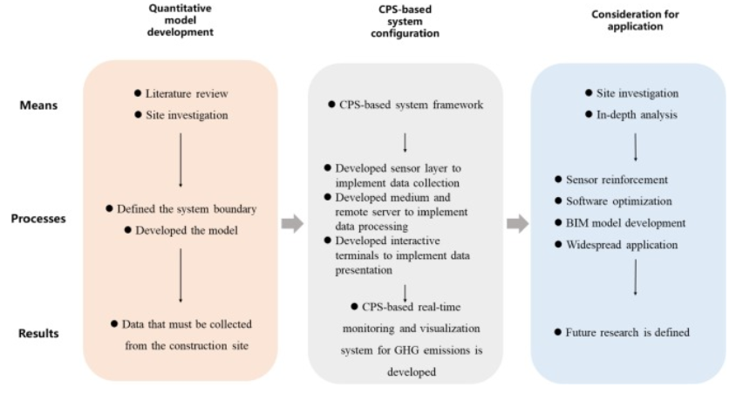
3. Methodology
The development and implementation of the system require addressing the following essential issues. To deal with these challenges, research was conducted in three parts, as shown in Fig. 1: quantitative model development, CPS-based system configuration, and consideration for application.
Fig. 1. Framework of the methodology.

Slide 9
3. Methodology
3.1. Quantitative model development
○ System boundary definition: In prefabrication sites, many construction or related activities can produce GHGs due to energy consumption Thus, the system boundary of this study is limited to the GHG emissions of construction machineries.
○ Model development: The quantitative calculation model of the GHG emissions of construction machineries can guide the development of the CPS-based system. From the analysis of the operation characteristics, this study establishes quantitative models for three types of machinery commonly used in construction sites: tower cranes, construction elevators, and transfer vehicles.

Slide 10
3. Methodology
3.2. CPS-based system configuration
○ Data collection: In accordance with the quantitative calculation model of GHG emissions, the running time of construction machinery must be collected in real time. Thus, three types of wireless sensors were selected: (1) acceleration sensors, which were adopted to collect the running time of tower cranes; (2) barometric sensors, which were used to collect the running time of construction elevators; and (3) Global Positioning System (GPS) sensors, which were applied to collect the running time of transfer vehicles.
○ Data processing: After data were collected, they were transmitted within the system through certain media, and the system calculated and stored real-time GHG emissions in accordance with the existing quantitative model in a remote server.
○ Data presentation: To allow management personnel to view GHG emission data and the working state of construction machinery, the system displays GHG emission data visually on a desktop and a portable device. In addition, users can input relevant information through these terminals to interact with the system.

Slide 11
3. Methodology
3.3. Consideration for application
○ Sensor reinforcement: Real-time data acquisition requires a highly stable hardware system. To achieve this goal, sensors must be continuously strengthened to ensure a stable application process.
○ Software optimization: The software system plays a key role in real-time data processing and presentation. The actual application process frequently includes a large amount of data from the construction site. This condition is a good test for the capacity and stability of the software system. Therefore, the software system must be constantly optimized to ensure the smooth progress of the application process.
○ BIM model development: The data visualization results of a BIM model are typically better than those of other lightweight models. Therefore, a BIM model for displaying the data must be developed to further assist management personnel in their work.
○ Widespread application: To accelerate the development of prefabricated buildings and the realization of low-carbon construction, the CPS-based system must be extensively applied. Therefore, the widespread application of the system must be considered.

Slide 12
4. Quantitative model development
Quantitative models must be established to calculate the GHG emissions of construction sites. First, several GHG emission sources were selected for the research by defining the system boundary. Second, a number of formulas and related parameters were utilized to establish quantitative models for the GHG emissions of construction sites.
4.1. System boundary definition
○ construction site has many GHG emission sources because it is typically the most complex stage in the construction life cycle. Sandanayake divided GHG emissions into direct and indirect emissions. Direct GHG emissions refer to emissions associated with construction activities, such as the fuel consumption of equipment and transport vehicles; indirect GHG emissions refer to emissions associated with the consumption of materials and electricity (Sandanayake et al., 2017).
○As shown in Fig. 2, a construction site can be typically divided into construction, living, and office areas (Li and Chen, 2017). The living and office areas of a construction site can also produce GHG emissions due to the use of various electrical appliances. these areas only account for a small percentage of the total GHG emissions of a construction site. Therefore, this study only considers GHG emissions from construction areas.

Slide 13
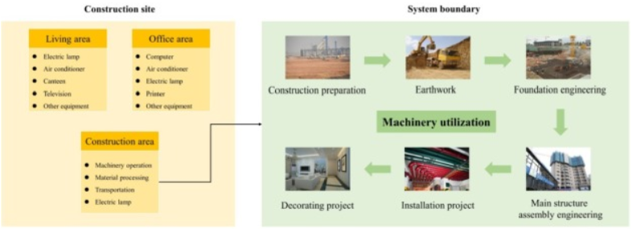
4. Quantitative model development
Fig. 2. Calculation boundary of the proposed system.

Slide 14
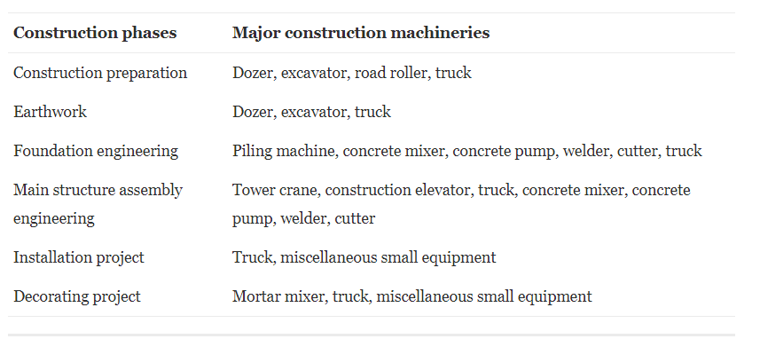
4. Quantitative model development
Electricity and fuel consumption by machineries in construction areas produce a considerable proportion of GHGs (Li and Chen, 2017). Electricity consumption, which accounts for the highest proportion of GHG emissions, exhibits the highest potential for emission reduction (Hong et al., 2015). Thus, this study focused on GHG emissions from construction machineries, as shown in Fig. 2.
Table 2. Major machineries used in prefabricated buildings.

Slide 15
4. Quantitative model development
4.2. Model development
○ Once the system boundary is determined, the calculation model for GHG emissions can be developed using GHG emission factors based on process analysis. This method has been adopted in many studies to calculate the GHG emissions of various construction machineries, equipment, and activities (Hong et al., 2015, Li and Chen, 2017, Zhang et al., 2013).
○ In the CPS-based system proposed in this work, sensors are used to perceive the running state of machinery. Therefore, electricity and fuel consumption can be determined through the rated power or energy consumption of machinery. Subsequently, GHG emissions can be calculated through GHG emission factors. Lastly, the GHG emissions of each piece of equipment are summarized to obtain the total GHG emissions.
○ Theoretically, GHG emissions generated by all types of machinery used during the construction process can be calculated using the aforementioned methods. As a preliminary attempt, this study selected three types of machine used during major structure assembly in the engineering stage for CPS-based real-time monitoring and visualization, namely, tower cranes, construction elevators, and transfer vehicles.

Slide 16
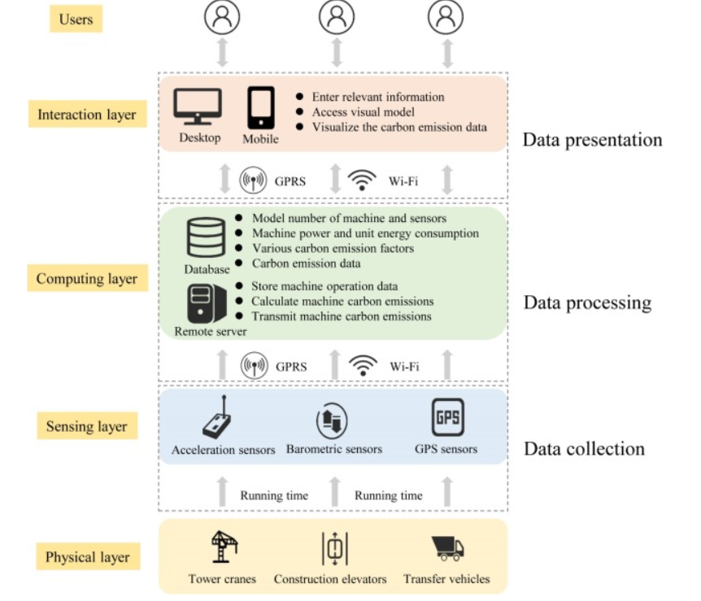
5. CPS-based system configuration
○ The overall framework of the system should be built to ascertain the functions of each part and the interactive logic between each part. This condition is beneficial for realizing system functions.
○ The system consists of three major parts: the sensing, computing, and interaction layers (Fig. 3).
Fig. 3. System framework.

Slide 17
5. CPS-based system configuration
5.1. Data collection
○ A wireless sensor network is an important part of the sensing layer in CPS (Darwish and Hassanien, 2018). When it is attached to the physical architecture, a wireless sensor can collect the corresponding monitoring data and transmit them to the central controller through a certain path to collect real-time data (Petroulakis et al., 2015). Thus, wireless sensors are used in various industries
○ In the CPS-based monitoring system, wireless sensors exhibit the following characteristics: (1) sufficient stability and anti-interference ability, (2) high accuracy, (3) high reaction speed, and (4) easy to install and maintain.
○ Three types of wireless sensor were selected for this study on the basis of the aforementioned principles. First, acceleration sensors were attached to the crane boom or hook. Second, barometric sensors attached to the inner wall of the construction elevators . Third, GPS sensors were attached to the on-site transfer vehicles. All the running states were sent to the remote server via GPRS or Wi-Fi at certain time intervals for the subsequent processing of GHG emissions. In addition, a one-to-one correspondence between the sensor and the construction machine was created to facilitate the statistics of the running time of each machine.

Slide 18
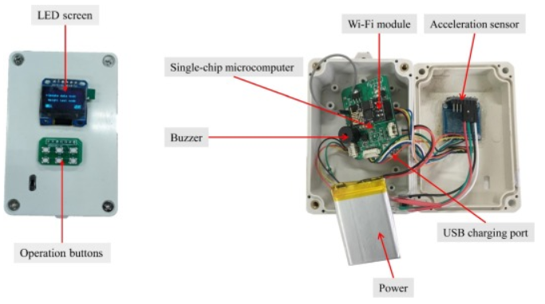
5. CPS-based system configuration
To apply practical engineering, sensors were assembled in the sensor box integrated with other components. As shown in Fig. 4, a LED screen outside the box displays the working status of the sensor box. Several corresponding operation buttons were used to control the working status of the sensor. Various components were connected inside the box through the main board: an acceleration sensor module, a power module, a USB charging port, a Wi-Fi module for data transmission, a single-chip microcomputer for data information processing, and a buzzer for giving sound alerts to the user when the sensor acts abnormally.
Fig. 4. Sensor appearance.

Slide 19
5. CPS-based system configuration
5.2.1. Remote server
○ The remote server performs the following functions: (1) determine and store the running time data of the machine, (2) calculate the GHG emissions of the machine, and (3) transmit the GHG emissions of the machine. In particular, the running time of the machine is identified by the server and stored first in the server, denoted as Tt, Te, and Tv. Thereafter, the required data, including machine power, energy consumption index, and GHG emission factors, are automatically extracted from the database to the server

Slide 20
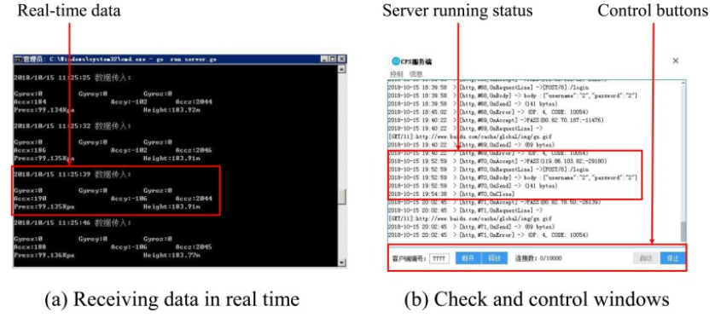
5. CPS-based system configuration
The server can calculate GHG emissions through the pre-written calculation model. The proposed system adopts the Apache server. Given its high cross-platform support and security features, Apache has become one of the most popular web servers
Fig. 5. Apache server.

Slide 21
5. CPS-based system configuration
5.2.2. Database
○ The database acts as a data warehouse that stores the following data: (1) model numbers of machine and corresponding sensors, (2) machine power and unit energy consumption, (3) various GHG emission factors, and (4) GHG emission data. After the remote server calculates the GHG emissions of machine, the database receives and stores emission data transmitted from the remote server. The emission data can also be accessed using the interaction layer.
○ The MySQL database, which is an open-source relational database management system that is preferred due to its favorable speed, reliability, and adaptability, was selected for this study. MySQL is the best choice for managing data content in the absence of transaction processing. It stores each data set in the platform as a list to allow its retrieval at any time, as shown in Fig. 6.

Slide 22
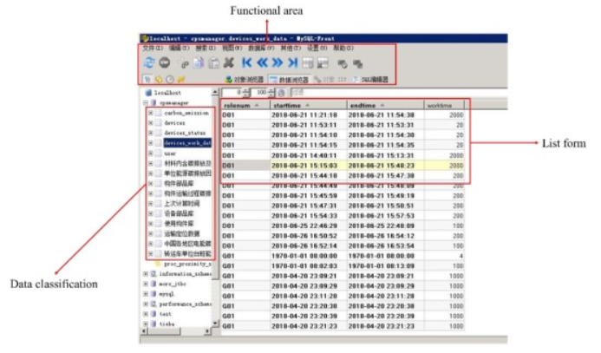
5. CPS-based system configuration
Fig. 6. Database access interface.

Slide 23
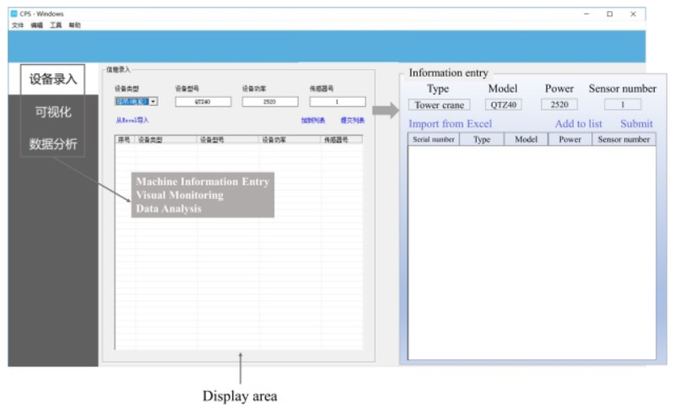
5. CPS-based system configuration
5.3.1. Desktop
○ Users can interact with the system using an application on the desktop. In the application, three basic interfaces are utilized to enable interaction, namely, machine information entry interface, visual monitoring interface, and data analysis interface, as shown in Fig. 7.
Fig. 7. Information entry interface.

Slide 24
5. CPS-based system configuration
5.3.1. Desktop
○ In the machine information entry interface, users can manually input the type, model, power, or unit of energy consumption of machinery and the number of corresponding sensors into the system before the system works through the manual input bar.
○ In the visual monitoring interface, users can access the visual model of construction machinery, which is embedded into the desktop applications, as shown in Fig. 8. Lightweight visual models are adopted and accessed through this interface in the primary edition. This method connects the physical world to the digital world, creating a visual model of GHG emission data for a construction site. The interface can show the running state, running duration, and accumulated GHG emissions of construction machinery in the status bars, marked in Fig. 8.
○ When the GHG emissions of construction machinery exceed the preset value, the visual model will issue a text warning, which can be used by construction personnel to take appropriate management measures

Slide 25
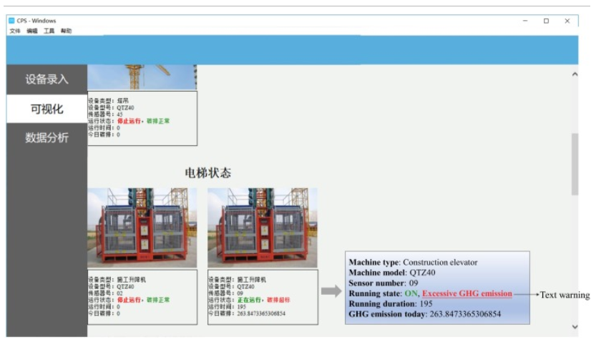
5. CPS-based system configuration
Fig. 8. Visual monitoring interface.

Slide 26
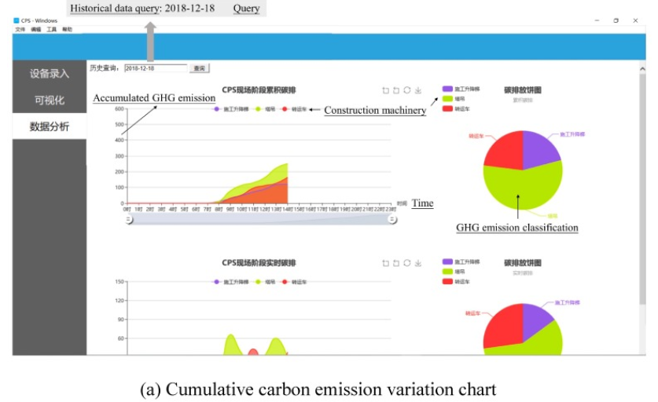
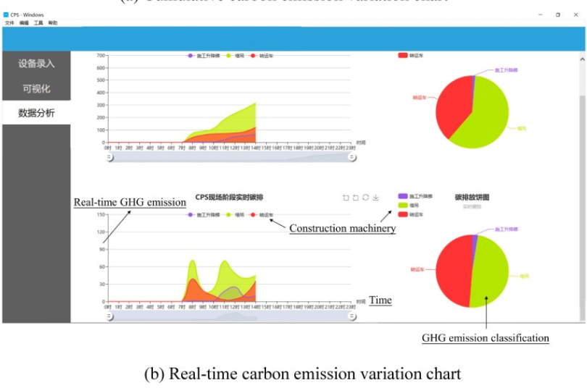
5. CPS-based system configuration
Fig. 9. Data analysis interface..

Slide 27
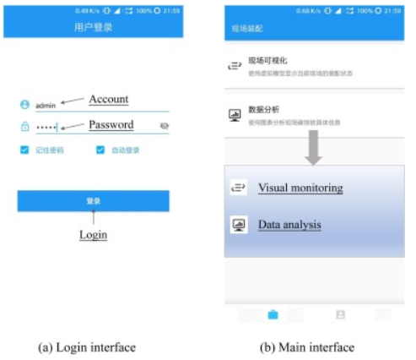
5. CPS-based system configuration
5.3.2. Portable device
○ The development of a portable device enables users to access the system anytime and anywhere. In the CPS-based system, mobile devices with specially developed applications are adopted. As shown in Fig. 10, users must first enter a password to log in to the system for security. In the main interface, two interfaces, which are the same as those in the desktop, are available for users to operate. They present the same data monitoring and analysis results as those on the desktop, as shown in Fig. 11.
Fig. 10. Mobile app interface.

Slide 28
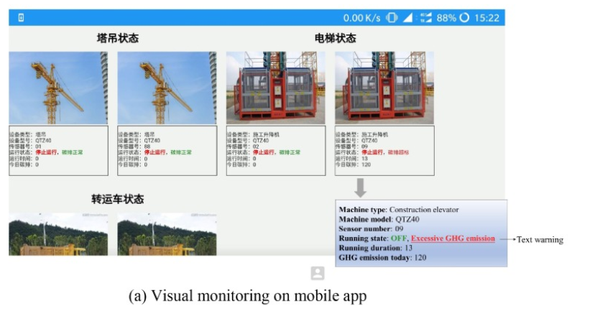
5. CPS-based system configuration
Fig. 11. Data monitoring and analysis results on mobile app.

Slide 29
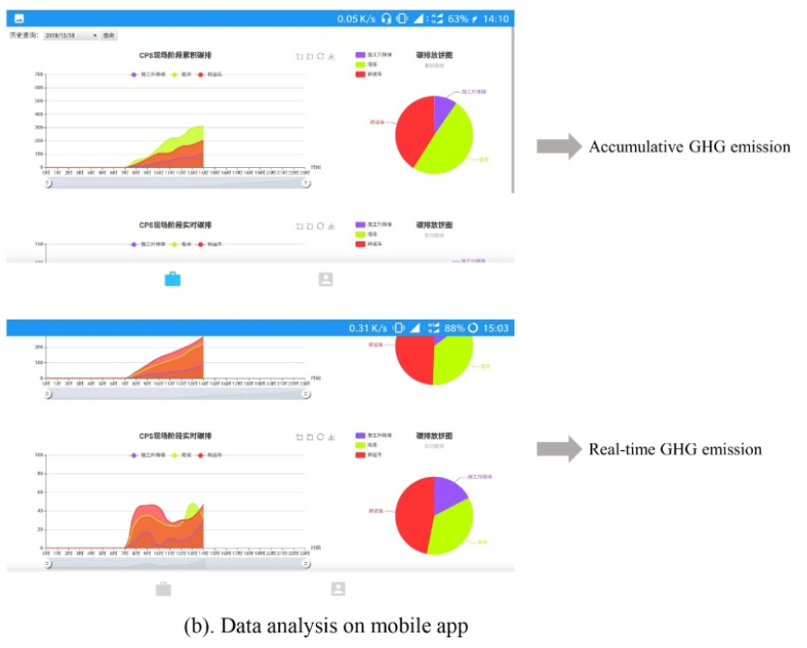
5. CPS-based system configuration
Fig. 11. Data monitoring and analysis results on mobile app.

Slide 30
5. CPS-based system configuration
5.3.4. Communication network
○ As a basic medium for information and data transmission, the communication network is essential for the effective integration of all parts of a system. In this study, the communication network must exhibit the following characteristics: (1) favorable stability, (2) fast transmission speed, and (3) high data transmission capacity. WLAN was selected to implement the communication network on the basis of the aforementioned characteristics.
○ For the remote server, database, and interaction layer, WLAN was also adopted to implement data access and transmission functions. Given the particularity of the mobile phone terminal, it can access the system through GPRS to ensure convenient access for users. Thus, all parts of the CPS-based system were effectively integrated.
○ The system developed in this study can be used for the real-time monitoring of GHG emissions in construction sites. Moreover, GHG emission intensity can be conveniently obtained for each on-site construction activity under different construction machinery conditions.

Slide 31
6. Considerations for application
○ The proposed system was developed with a full understanding of the actual conditions prevailing at a construction site. The feasibility of the system was verified preliminarily, but its complete application remains lacking.
○ First, the operational method of all types of sensors must be improved. Favorable fastening devices to reliably achieve fixation are currently unavailable for the sensor-integrated box, easily leading to the instability of the GHG emission monitoring system or making it dangerous to use in actual projects.
○ Second, the sensors, servers, and databases used in the current system are relatively common versions. When the experimental data become extremely large, the bearing capacity of the servers and databases may reach a limit, and system coupling may be considerably affected, resulting in system failure. Therefore, the software components of the system will be optimized in the future to cope with complex situations.
○ The next step is to establish a BIM model for the construction site to achieve 3D visualization of GHG emission data and simultaneously enhance the two-way interaction between the physical and virtual world.
○ After verifying the practicability and stability of the system, mass production of sensors and corresponding software platforms should be conducted to extensively apply the system.

Slide 32
7. Conclusion
This study proposed developing a CPS-based real-time monitoring and visualization system for GHG emissions from prefabrication sites.
○ The system provides the following innovations. The first is the novelty of the research object. At present, only a few studies have been conducted on the real-time monitoring of GHG emissions during the on-site installation stage of prefabricated buildings. This study adds to the research on this aspect.
○ The second is the innovative research method. CPS technology is introduced to monitor GHG emissions. This practice has rarely been done in the past. Through the coupling of multiple subsystems, the real-time monitoring and visual presentation of GHG emission data in a construction site is preliminarily achieved
○ Third, compared with the direct measurement method of electricity consumption adopted in several studies, GHG emissions were calculated by measuring the operation time of machinery, which cannot only measure widespread GHG emissions but can also help optimize and schedule the construction process to a certain extent.

Slide 33
7. Conclusion
this study presents the following management results.
○ First, the ability of the system to record the GHG emissions of various construction activities enables the formation of a GHG emission database. This database can be utilized when making construction scheduling arrangements to achieve the multi-objective optimization of cost, schedule, quality, and GHG emissions.
○ Second, the mechanical operation in a construction site can be intuitively understood using the real-time change of system data, and the system can present the real-time virtual model of a construction site if combined with BIM.
○ the system proposed in this study must be further strengthened in terms of the visual presentation of GHG emission data and two-way interaction between the physical and virtual world. These issues will be addressed in future studies. Moreover, additional optimization and debugging work are required before the system can be used at a wider scale.

Slide 34
Q & A

